Slide 1
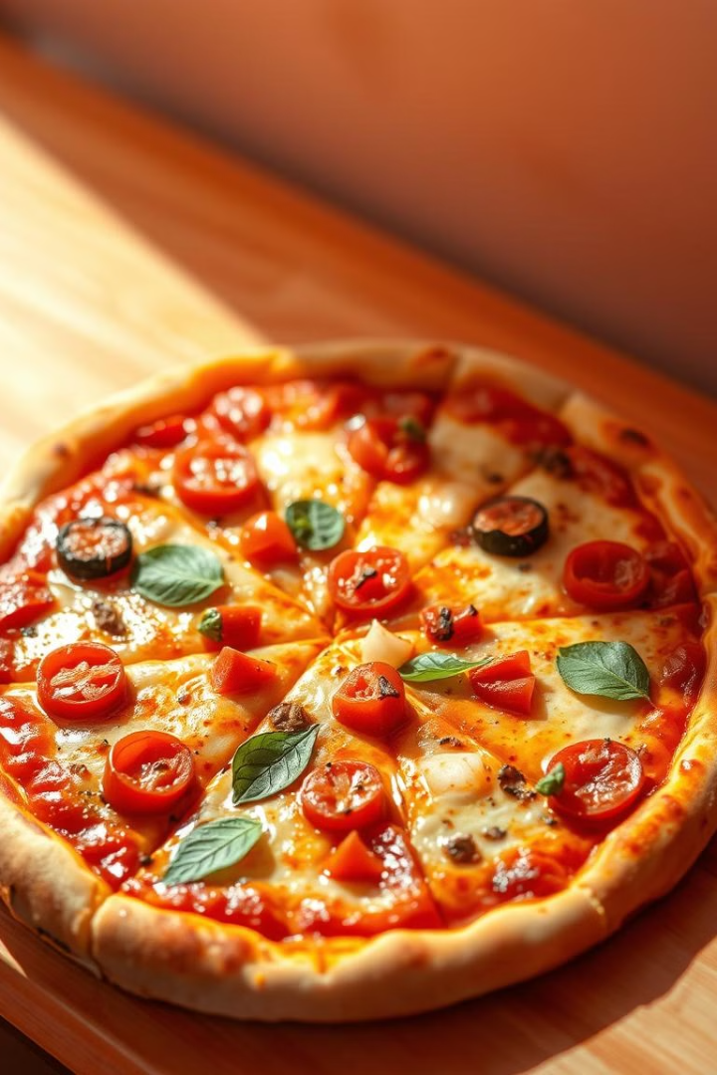

Pizza Sales Data Analysis
This analysis examines pizza sales data to uncover trends, identify customer preferences, and highlight opportunities for growth. By exploring various aspects of the data, we aim to gain valuable insights and support informed decision-making.
by Mohamad Gamal

Slide 2

Introduction and Objectives
This analysis aims to provide a comprehensive understanding of pizza sales data. By examining various aspects of the data, such as sales by category, size, and quarter, we can gain valuable insights into customer preferences, product performance, and overall business performance.
1
Understand customer preferences
2
Analyze sales trends
Identify seasonal variations, peak sales periods, and growth areas to optimize inventory and resource allocation.
Identify popular pizza categories, toppings, and sizes to tailor marketing and product offerings.
3
Evaluate operational efficiency
Identify ranges of times for improvement in order fulfillment, delivery times, and customer service to enhance the overall customer experience.

Slide 3
Sales Trends by Product Category
Analyzing sales trends by product category allows us to understand customer preferences and identify popular pizza types.
Classic Pizzas
Specialty Pizzas
Vegetarian Pizzas
These traditional pizzas are consistently popular, representing a stable base of sales. chart
These unique and innovative pizzas often drive growth and cater to adventurous palates.
The popularity of vegetarian options reflects a growing demand for plant-based choices and dietary preferences.

Slide 4
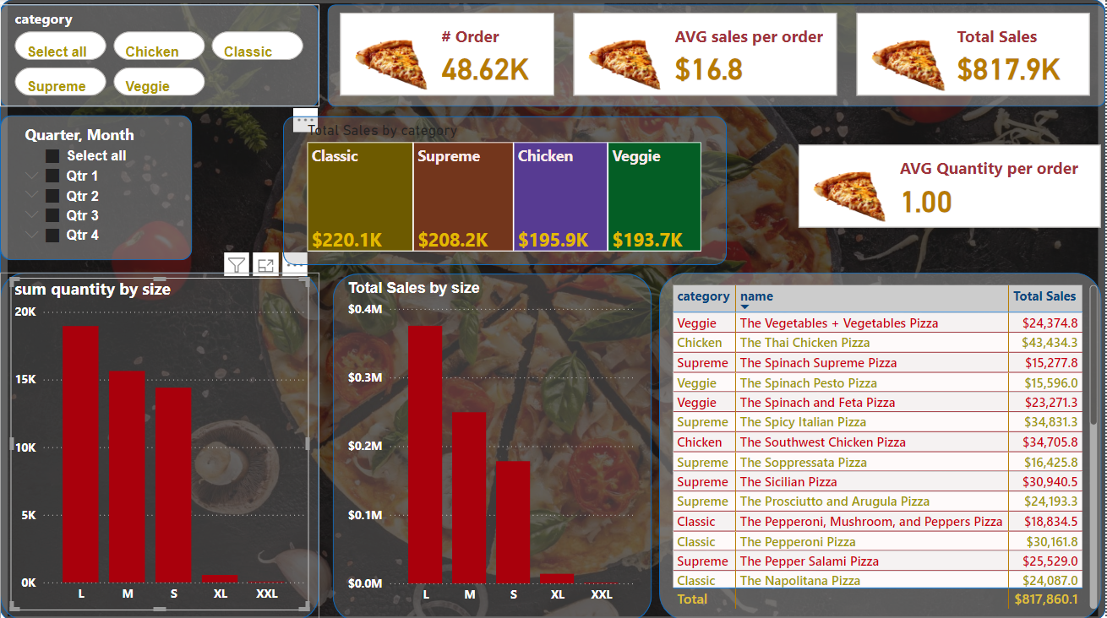

Slide 5
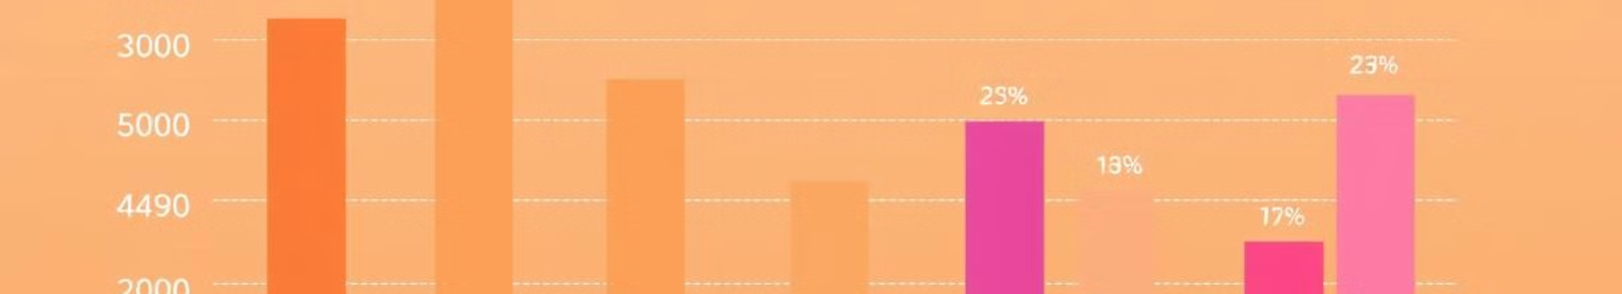
Understanding average sales per order and order size and total value of sales provides insights into customer purchase patterns and potential for upselling.
Overall Sales Performance
Total Sales: The total sales amount to $817,913.43, indicating the restaurant's overall revenue.
Average Sales per Order: The average sales per order are $16.8, providing insight into the typical purchase amount of customers.
Order Volume: A total of 48,620 orders have been placed, showing the restaurant's customer activity.
Sales by Category
Category Performance: The "Total Sales by Category" chart shows that Classic pizzas have the highest sales, followed by Supreme and Chicken pizzas. Veggie pizzas have the lowest sales.
Category Popularity: This analysis reveals customer preferences and can inform inventory management and marketing efforts.
Sales by Quarter and Month
Seasonal Trends: The "Total Sales by Category" chart allows for analyzing sales trends by quarter and month. This can help identify seasonal fluctuations and peak sales periods.
Quarterly Performance: Qtr 1 and Qtr 2 appear to have higher sales compared to Qtr 3 and Qtr 4, suggesting potential seasonal factors influencing sales.
Sales by Size
Size Popularity: The "Total Sales by Size" chart shows that Medium (M) pizzas have the highest sales, followed by Large (L) and Small (S) sizes. Extra-Large (XL) and Extra-Extra-Large (XXL) sizes have lower sales.
Size Preferences: This analysis indicates customer preferences for pizza sizes and can inform product offerings and pricing.
Product-Level Analysis
Top-Selling Pizzas: The dashboard provides information on the top-selling pizzas by name and total sales. This allows for identifying popular products and understanding customer preferences.
Product Profitability: Analyzing the sales and cost of each pizza can help assess product profitability and identify opportunities for improvement.

Slide 6
Understanding average sales per order and order size and total value of sales provides insights into customer purchase patterns and potential for upselling.
Recommendations for Further Analysis:
Customer Segmentation: Segment customers based on demographics, purchase history, or other criteria to identify specific customer segments with different preferences and needs.
Product Bundling: Explore opportunities to bundle popular pizzas or sides to increase average order values.
Marketing Campaigns: Analyze the impact of marketing campaigns on sales and customer behavior to optimize marketing efforts.
Inventory Management: Use sales data to optimize inventory levels and prevent stockouts or excess inventory.
Pricing Strategy: Evaluate the pricing strategy for different pizza sizes and categories to ensure profitability and competitiveness.
By conducting a comprehensive analysis of sales data, pizza restaurants can gain valuable insights into their customer preferences, product performance, and operational efficiency. This information can be used to make data-driven decisions to improve sales, profitability, and customer satisfaction.

Slide 7
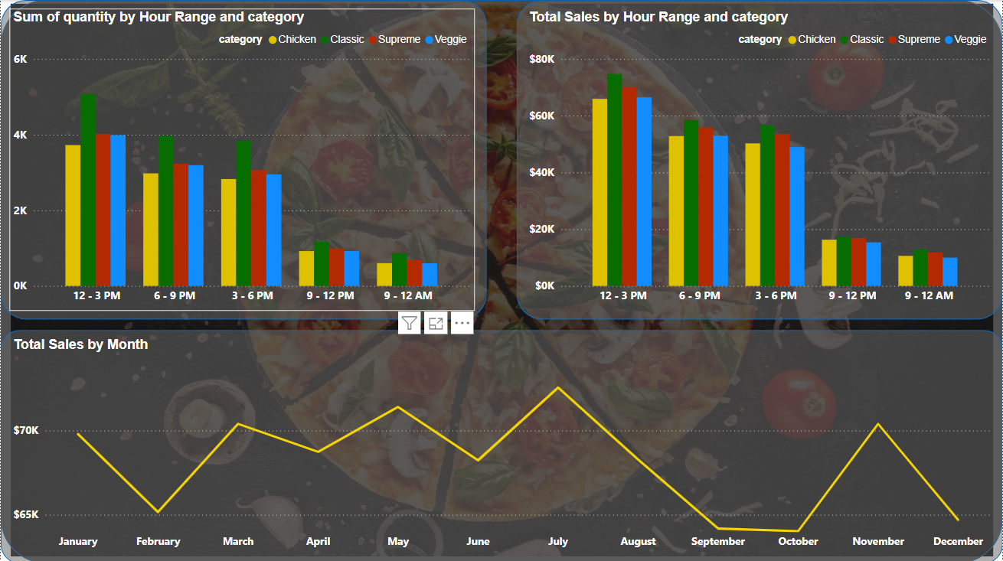

Slide 8

Sales Performance
Tracking sales performance reveals seasonal trends and identifies peak sales periods.
1
3
Sales typically increase as customers seek comfort food during warmer months.
Sales often surge as customers during time work
1
2
3
4
2
4
Sales may dip slightly as customers enjoy outdoor activities and lighter fare.
Sales tend to remain high due to holiday gatherings and festive occasions.

Slide 9
Hourly Sales Performance
Peak Sales Hours: The "Sum of Quantity by Hour Range and Category" chart shows that the busiest hours are between 6 PM and 9 PM, followed by 3 PM to 6 PM. This indicates peak dining times for the restaurant.
Category Performance by Hour: The same chart reveals that Classic pizzas consistently have the highest sales across all hour ranges, followed by Supreme and Chicken pizzas. Veggie pizzas have lower sales throughout the day.
Hourly Sales Trends: The "Total Sales by Hour Range and Category" chart provides a breakdown of sales by hour range and category. It shows that sales generally increase from 12-3 PM to 6-9 PM, with a slight dip between 9 PM and 12 AM.
Monthly Sales Trends
Seasonal Patterns: The "Total Sales by Month" chart indicates that sales are generally higher during the summer months (June, July, and August) and lower during the winter months (December, January, and February).
Peak Sales Months: July and August appear to be the peak sales months, while December and January have the lowest sales.
Category Performance
Category Popularity: Classic pizzas consistently have the highest sales across all hour ranges and months, suggesting that they are the most popular category among customers.
Category-Specific Trends: Analyzing sales by category and hour range can help identify specific products or times of day that are driving sales for each category.

Slide 10
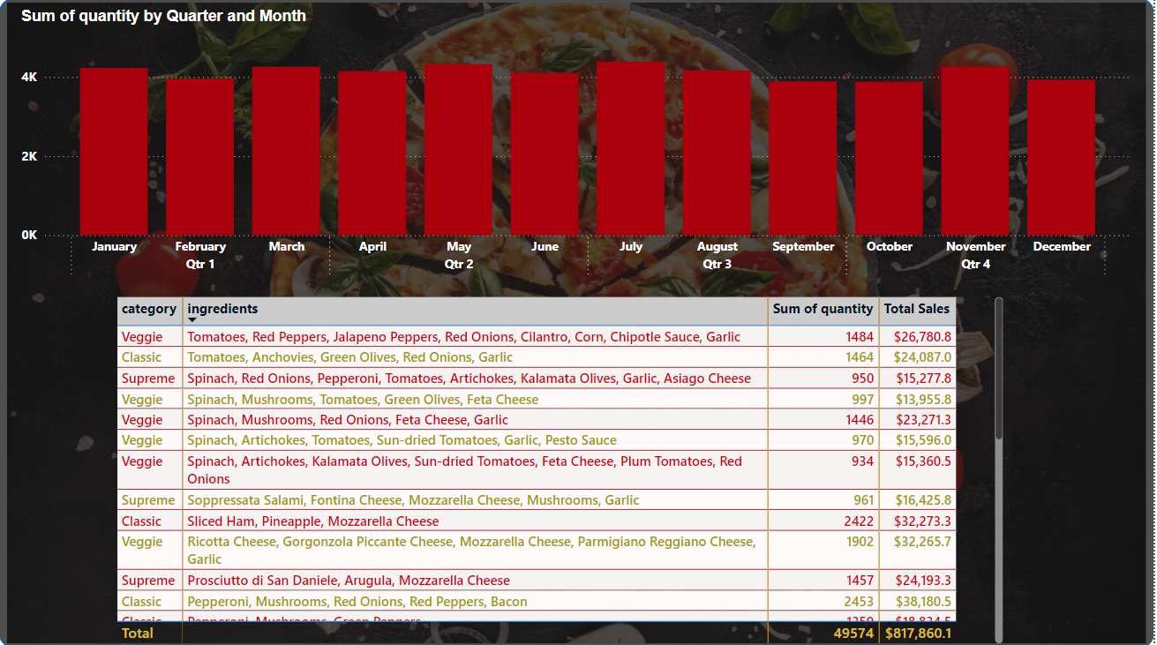

Slide 11

Quarterly Sales Performance
Peak Sales Quarters: Qtr 1 (January, February, and March) and Qtr 3 (July, August, and September) appear to be the peak sales quarters, with higher overall quantities sold compared to Qtr 2 and Qtr 4.
Seasonal Patterns: The chart suggests that sales may be influenced by seasonal factors, such as warmer weather in Qtr 1 and Qtr 3, which could lead to increased outdoor dining and demand for pizza.
Monthly Sales Trends
Month-by-Month Analysis: The chart provides a detailed breakdown of sales by month, allowing for a granular analysis of sales patterns.
Peak Sales Months: March and April seem to be the months with the highest sales, while December and January have the lowest sales.
Category Performance by Quarter and Month
Category Popularity: While the overall chart shows a general trend in sales by quarter and month, analyzing sales by category can provide more specific insights into the performance of each pizza type.
Seasonal Preferences: Certain pizza categories might be more popular during specific seasons or months. For example, lighter, veggie-based pizzas might be more popular in warmer months, while heartier classic pizzas might be preferred in colder months.
Product-Level Analysis
Top-Selling Pizzas: The dashboard provides information on the top-selling pizzas by name and total sales. This allows for identifying popular products and understanding customer preferences.
Product Profitability: Analyzing the sales and cost of each pizza can help assess product profitability and identify opportunities for improvement.

Slide 12

Conclusion
This analysis provides a comprehensive overview of pizza sales data, revealing valuable insights into customer preferences, product performance, and operational efficiency.

